Slide 1

school of electrical engineering and computing department of computer science and engineering program
Adama Science and Technology University
Name: shambel mebratu
ID: R/1055/08 Advisor: mr. Ashenafi Duguma Hosting organization: Mizan-Tepi university

Slide 2
description of the my hosting organization (mizan-tepi university (mtu))
Mizan-Tepi University is one of the Universities in Ethiopia which is found in south nation, nationalities and peoples region.
It is located at Mizan-Teferi, where the main campus is, 565kms at southwest of Addis Ababa and Tepi town 578kms at southwest of Addis Ababa
The University started teaching and learning in 2006. By the time the university started its operation, there were only 215 students attending their first degree classes. Among this number of students, for the first time, 138 students had graduated colorfully in July 2008/09.

Slide 3
benefit gained from the internship
Have personal growth experiences.
Increase self-confidence in the workplace
Face problems
Build my network:
Management of Time:

Slide 4
procedure I have used to develop my project
collect requirement
I read text books and watch some video tutorial.
Install xampp server on my pc.
Start codding

Slide 5
development tools for my project
hardware:
laptop
flash drive
software: (technical knowledge and skill from my course)
php programming language
HTML, CSS, bootstrap…..
xampp server
sublime text editor
MySQL database
Mozilla Firefox Internet Browser.

Slide 6
major duty
Major duty given to me was to develop library management system
Expected output After finish my project is.
My LMS has user side and admin side.
User can use:
Library catalog i.e. search book by using title, author or year of publication.
Circulation service
Loan service
Give comment

Slide 7
CONTI…..
Admin can:
Insert new book, update, delete
Check loan and borrowed status
Update news
See comment and delete unwanted or old news

Slide 8
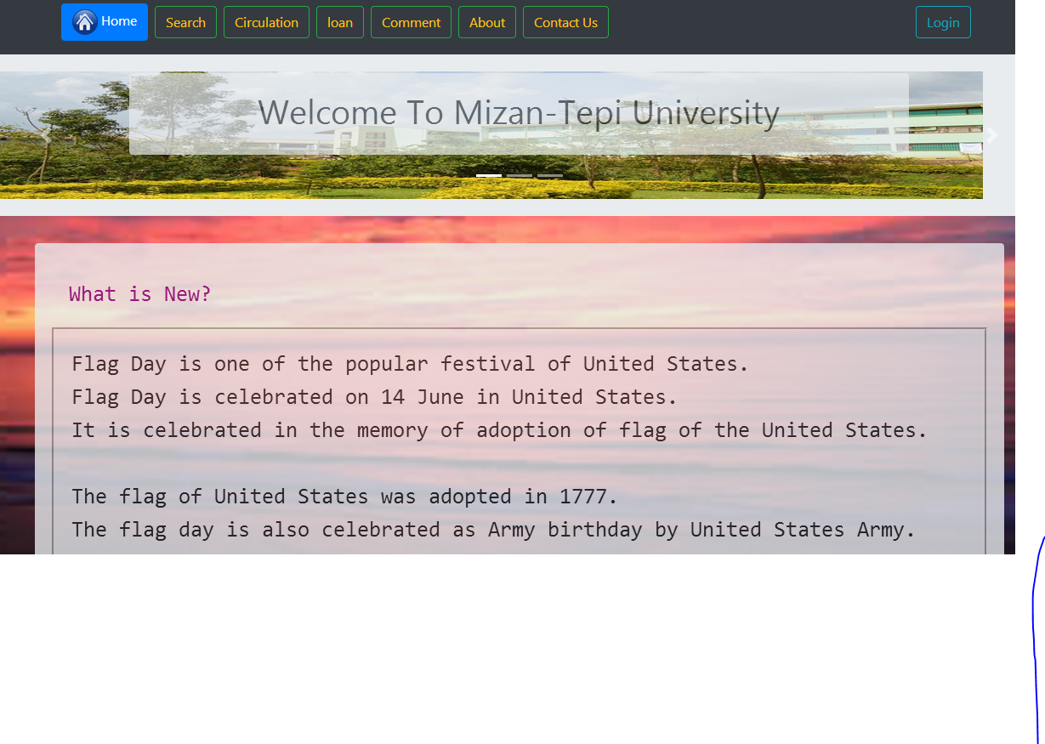
My final project (library management system)
User
Home page

Slide 9
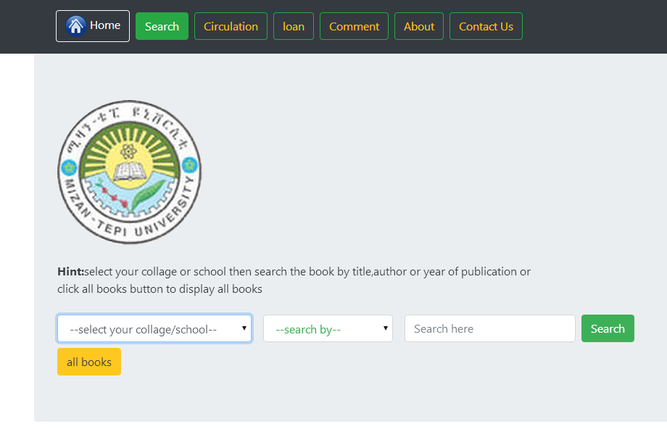
Conti…..
catalogue (search page)

Slide 10
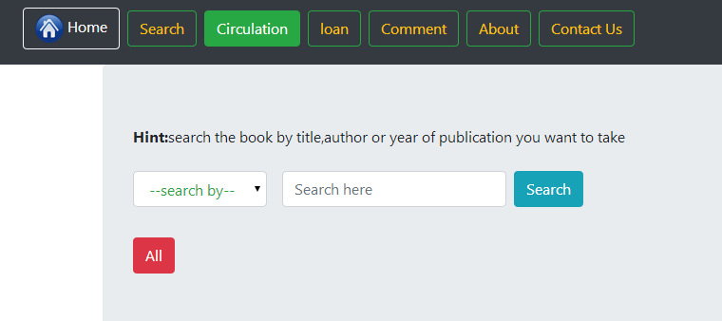
Conti…..
Circulation page

Slide 11
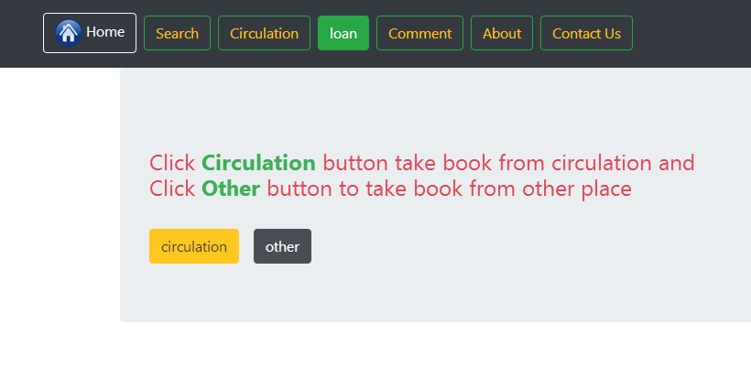
Conti……
Loan page

Slide 12
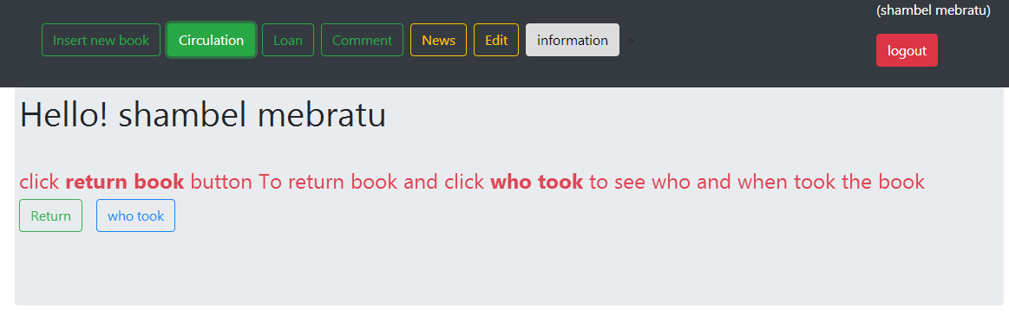
Admin
Return and view status page

Slide 13
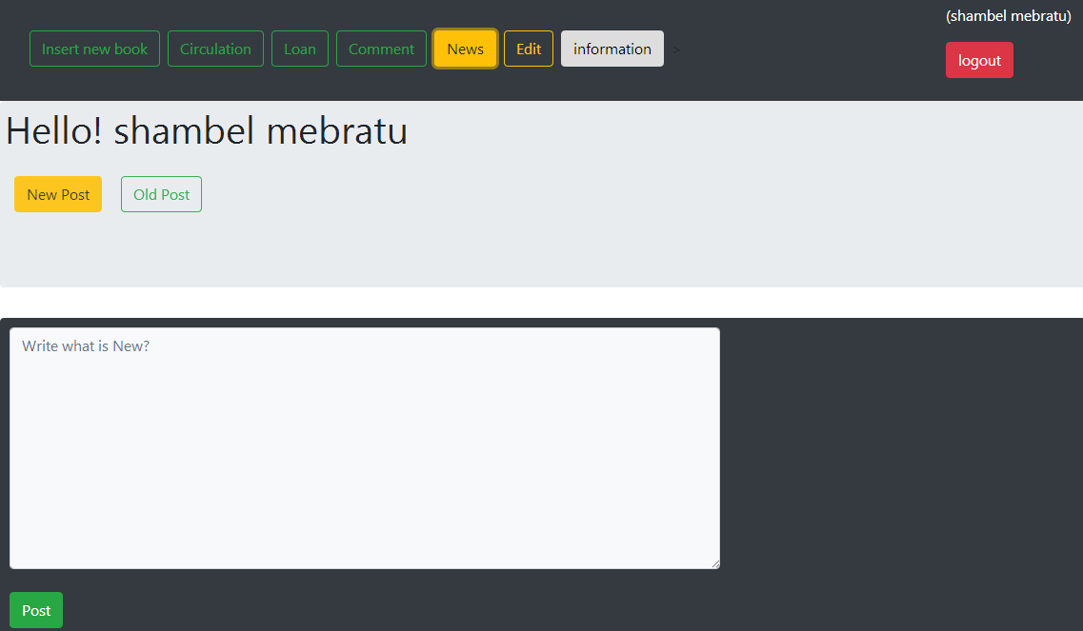
Conti…..
Post and delet news

Slide 14
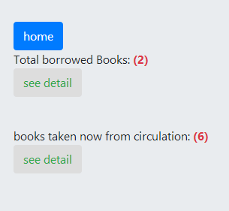
Conti…..
See total borrowed and taken book

Slide 15
Conclusion
I get vast of knowledge from this internship, I spend my full summer time for reading and doing this project.
Developed my programming skill.
Developed my problem-solving technique, facing problem
Face challenges.
Spend time for good.

Slide 16
Thank you

